Slide 1

MEDIA PLAN FOR
KAVERI SILKS
Premium OOH, DOOH & Mall Media • 4 Sites • 1 Month
Northstar Outdoor

Slide 2

Mall & Indoor Media
Northstar Outdoor

Slide 3
01 / 37
LED Screen Outside the Mall
LED Screen Outside the Mall · Koregaon Park · Pune
SIZE (FT)
LED Screen
30 (W) x 15 (H)
RESOLUTION
2160 x 1200

Slide 4
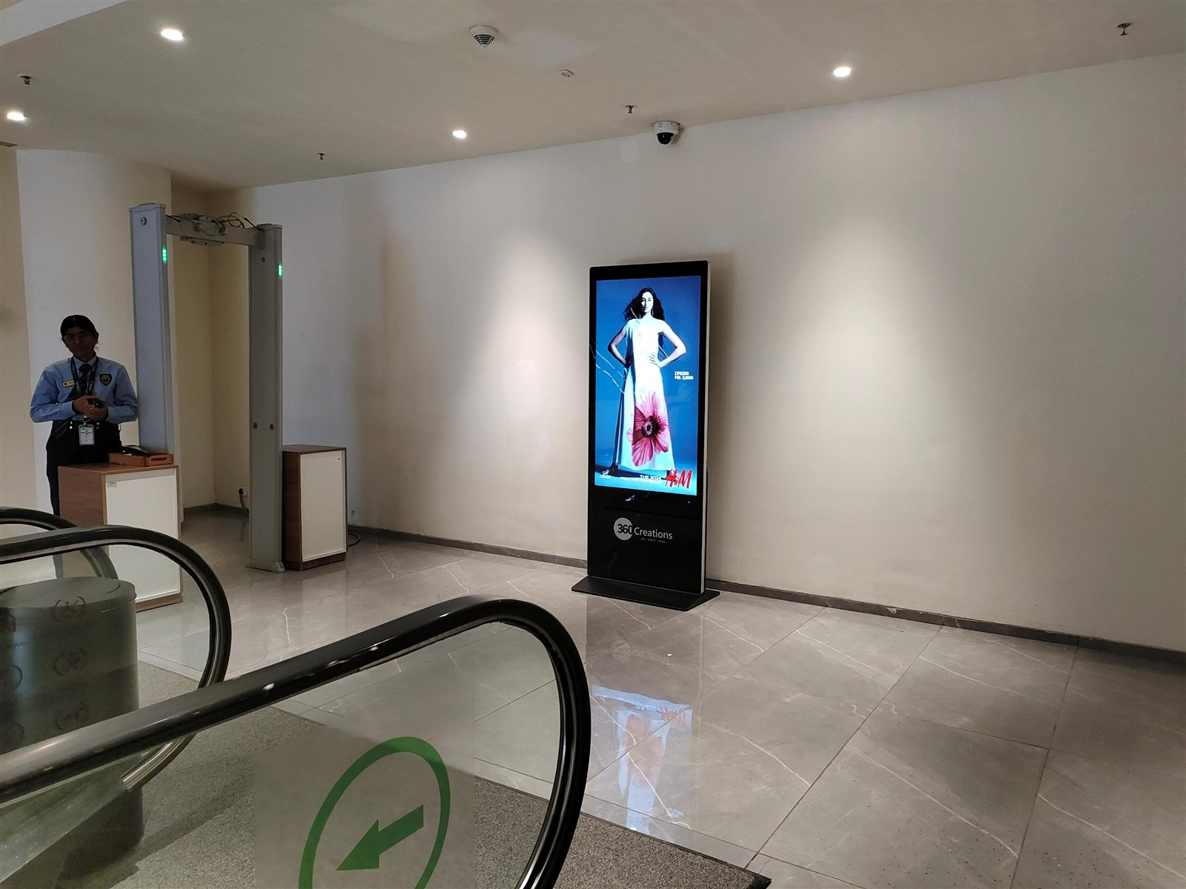
02 / 37
Basement One, Beside The Escalator â€“ Single Side Display · Koregaon Park · Pune
SIZE (INCHES)
Digital Pod
55"
RESOLUTION
2160 x 1200

Slide 5
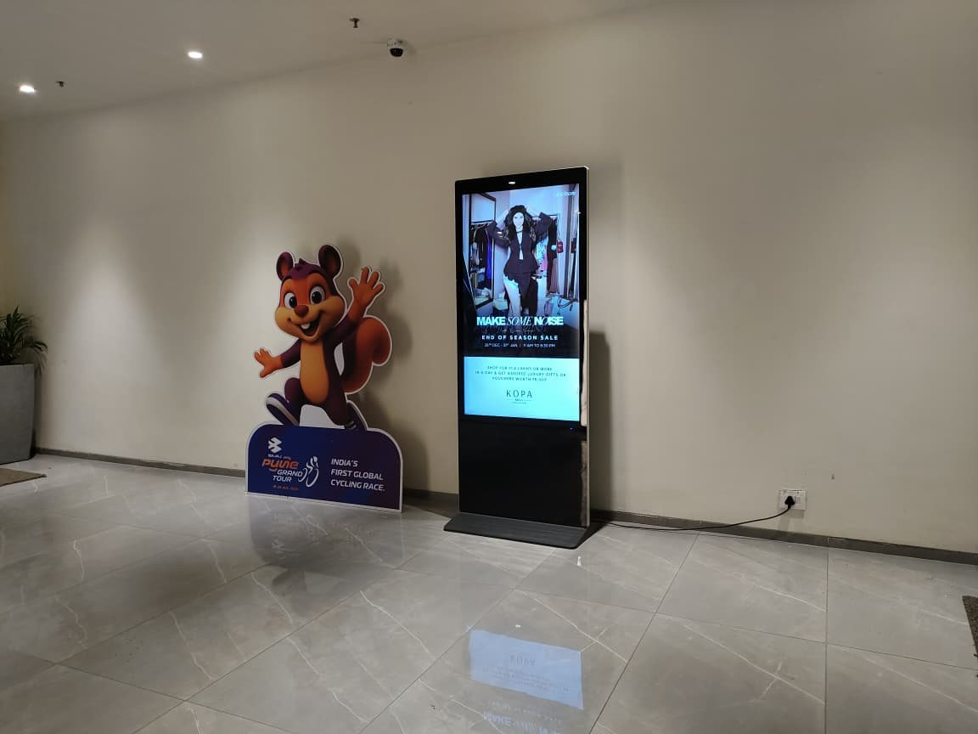
03 / 37
Basement One, Beside The Escalator â€“ Single Side Display · Koregaon Park · Pune
SIZE (INCHES)
Digital Pod
55"
RESOLUTION
2160 x 1200

Slide 6
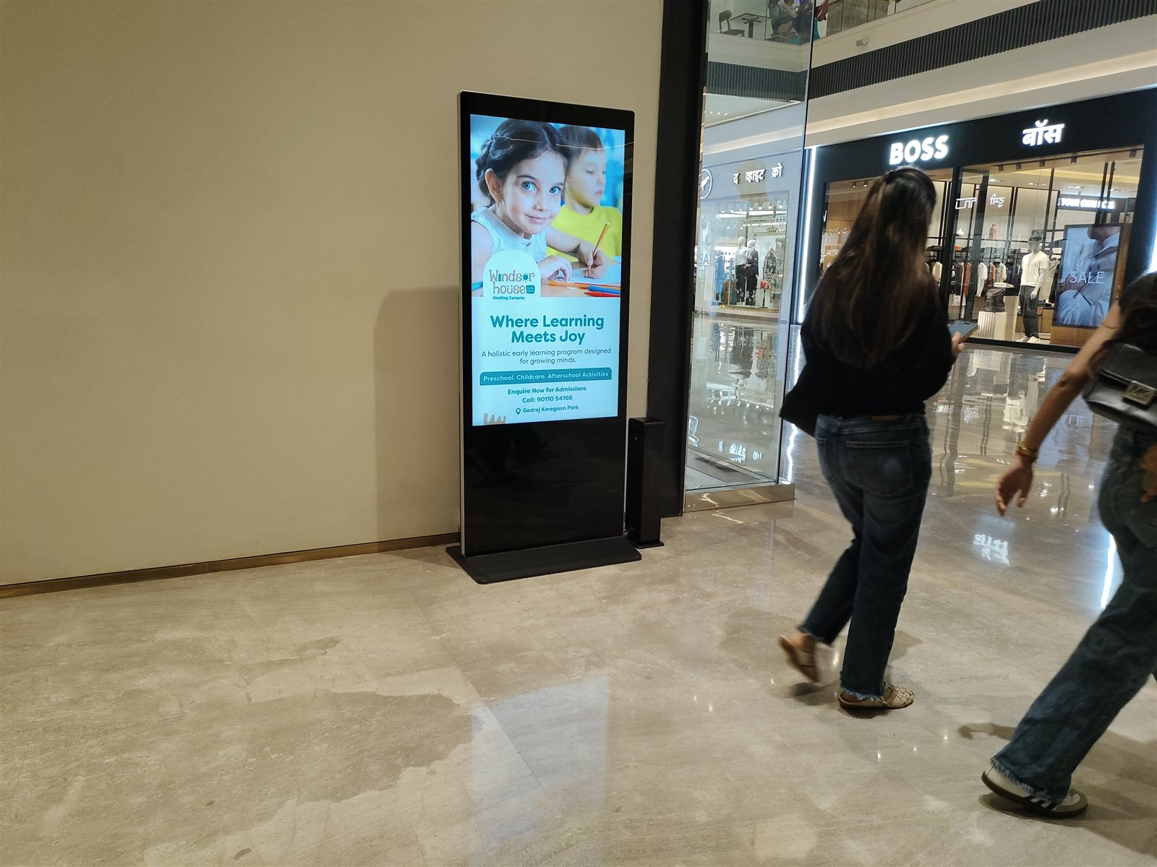
04 / 37
Ground Floor, Beside Michael Korsâ€“ Single Side Display · Koregaon Park · Pune
SIZE (INCHES)
Digital Pod
55"
RESOLUTION
2160 x 1200

Slide 7
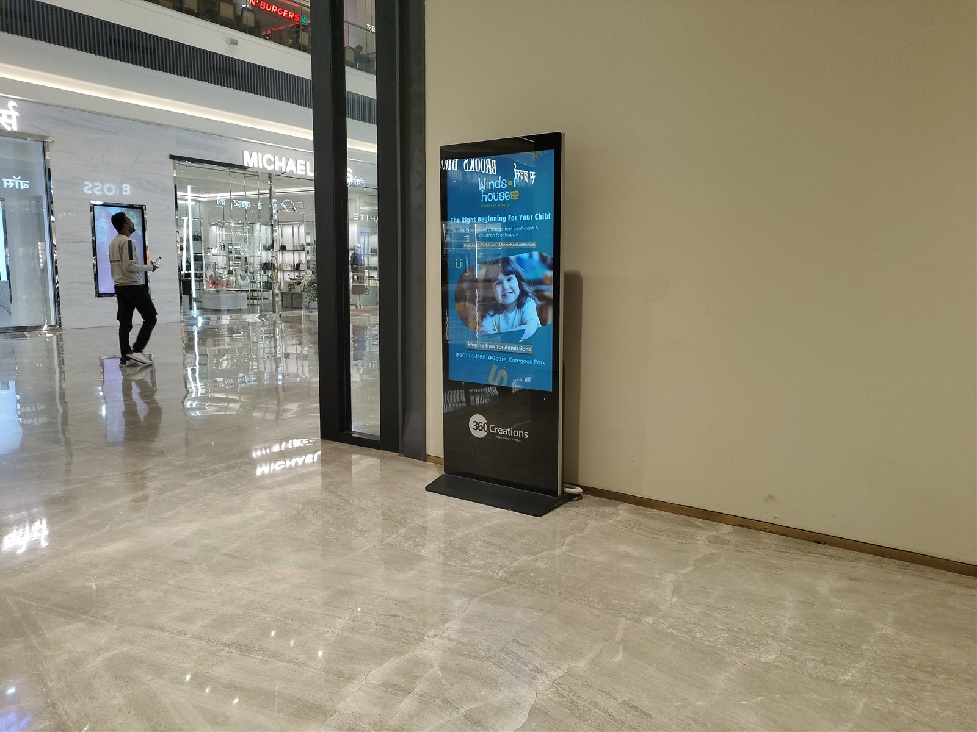
05 / 37
Ground Floor, Beside Sunglasses Hutâ€“ Single Side Display · Koregaon Park · Pune
SIZE (INCHES)
Digital Pod
55"
RESOLUTION
2160 x 1200

Slide 8
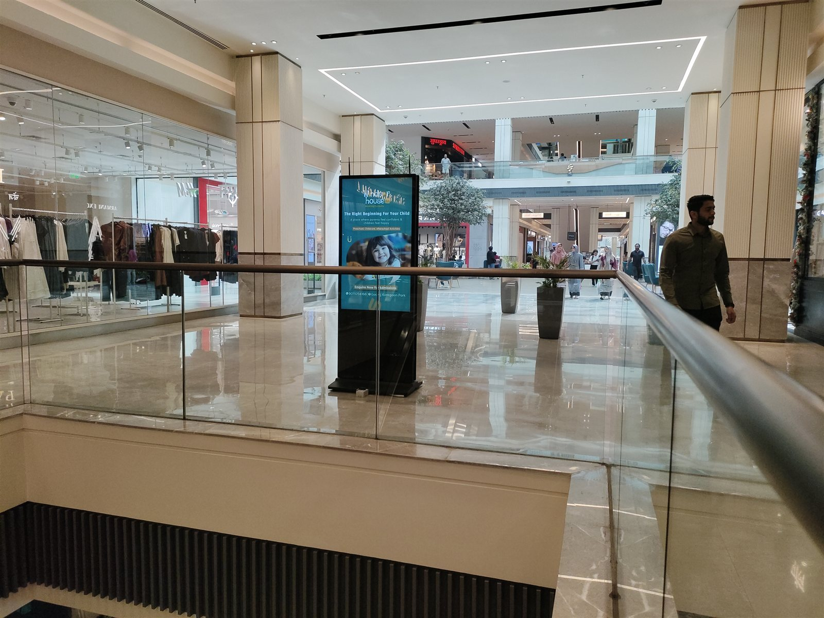
06 / 37
Ground Floor, Beside Nappadoriâ€“ Double Side Display · Koregaon Park · Pune
SIZE (INCHES)
Digital Pod
55"
RESOLUTION
2160 x 1200

Slide 9
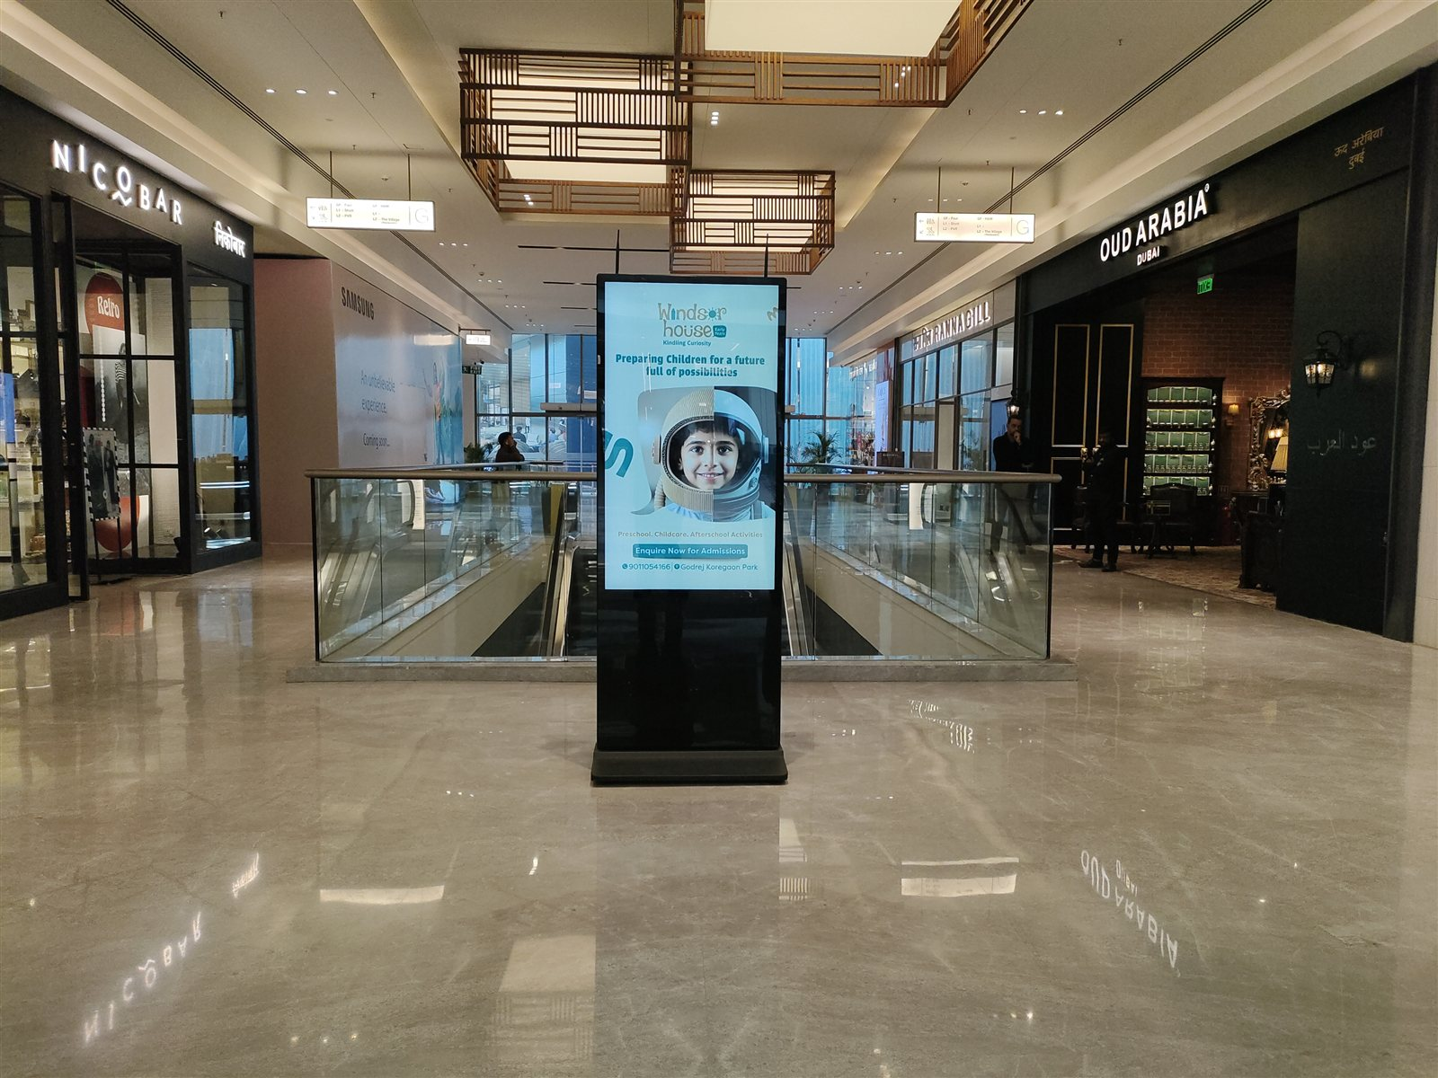
07 / 37
Ground Floor, Beside Nappadoriâ€“ Double Side Display · Koregaon Park · Pune
SIZE (INCHES)
Digital Pod
55"
RESOLUTION
2160 x 1200

Slide 10
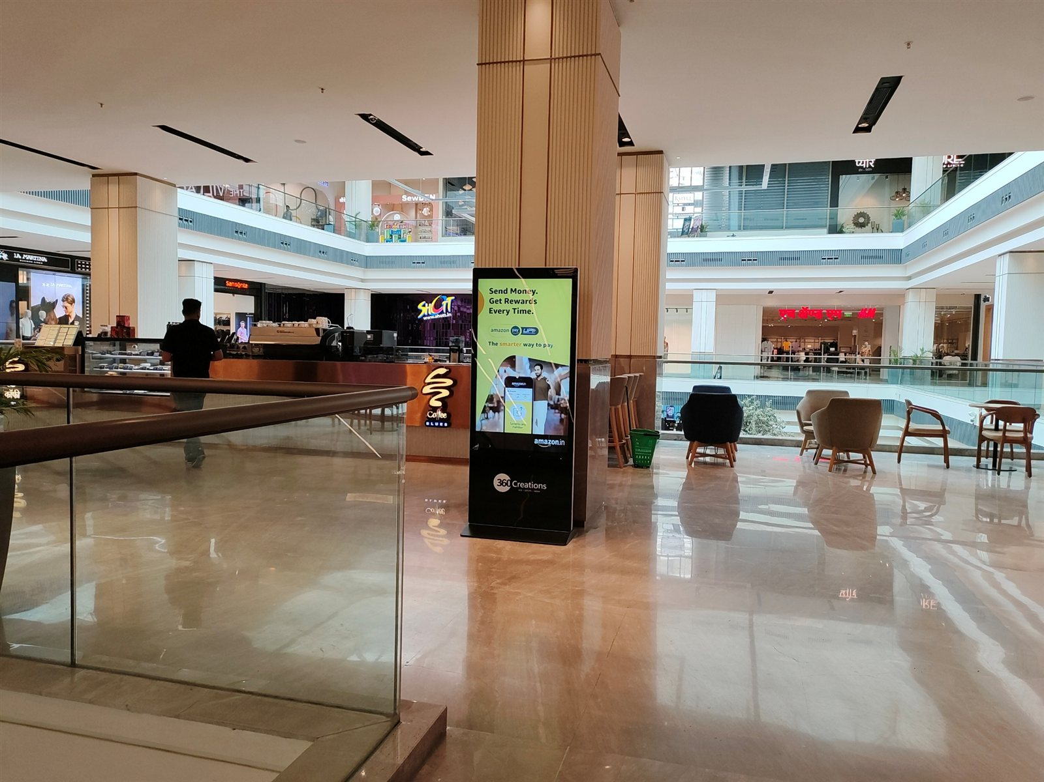
08 / 37
First Floor, Near Coffee Bluesâ€“ Single Side Display · Koregaon Park · Pune
SIZE (INCHES)
Digital Pod
55"
RESOLUTION
2160 x 1200

Slide 11
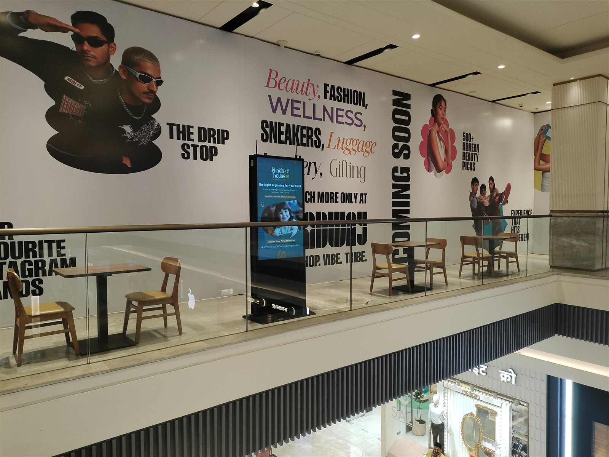
09 / 37
First Floor, Near Broadwayâ€“ Double Side Display · Koregaon Park · Pune
SIZE (INCHES)
Digital Pod
55"
RESOLUTION
2160 x 1200

Slide 12
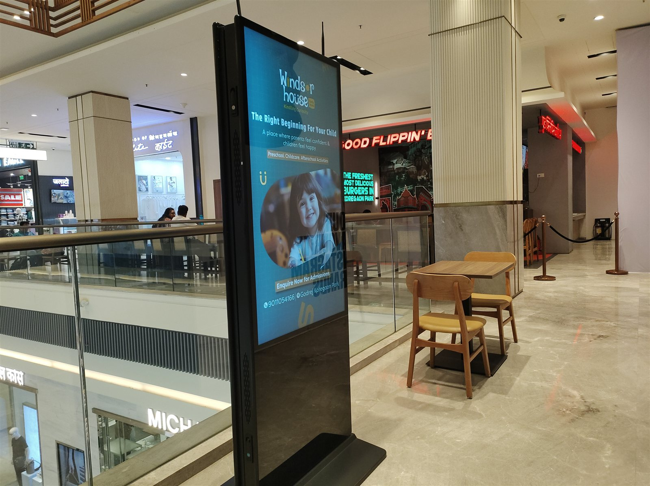
10 / 37
First Floor, Near Broadwayâ€“ Double Side Display · Koregaon Park · Pune
SIZE (INCHES)
Digital Pod
55"
RESOLUTION
2160 x 1200

Slide 13
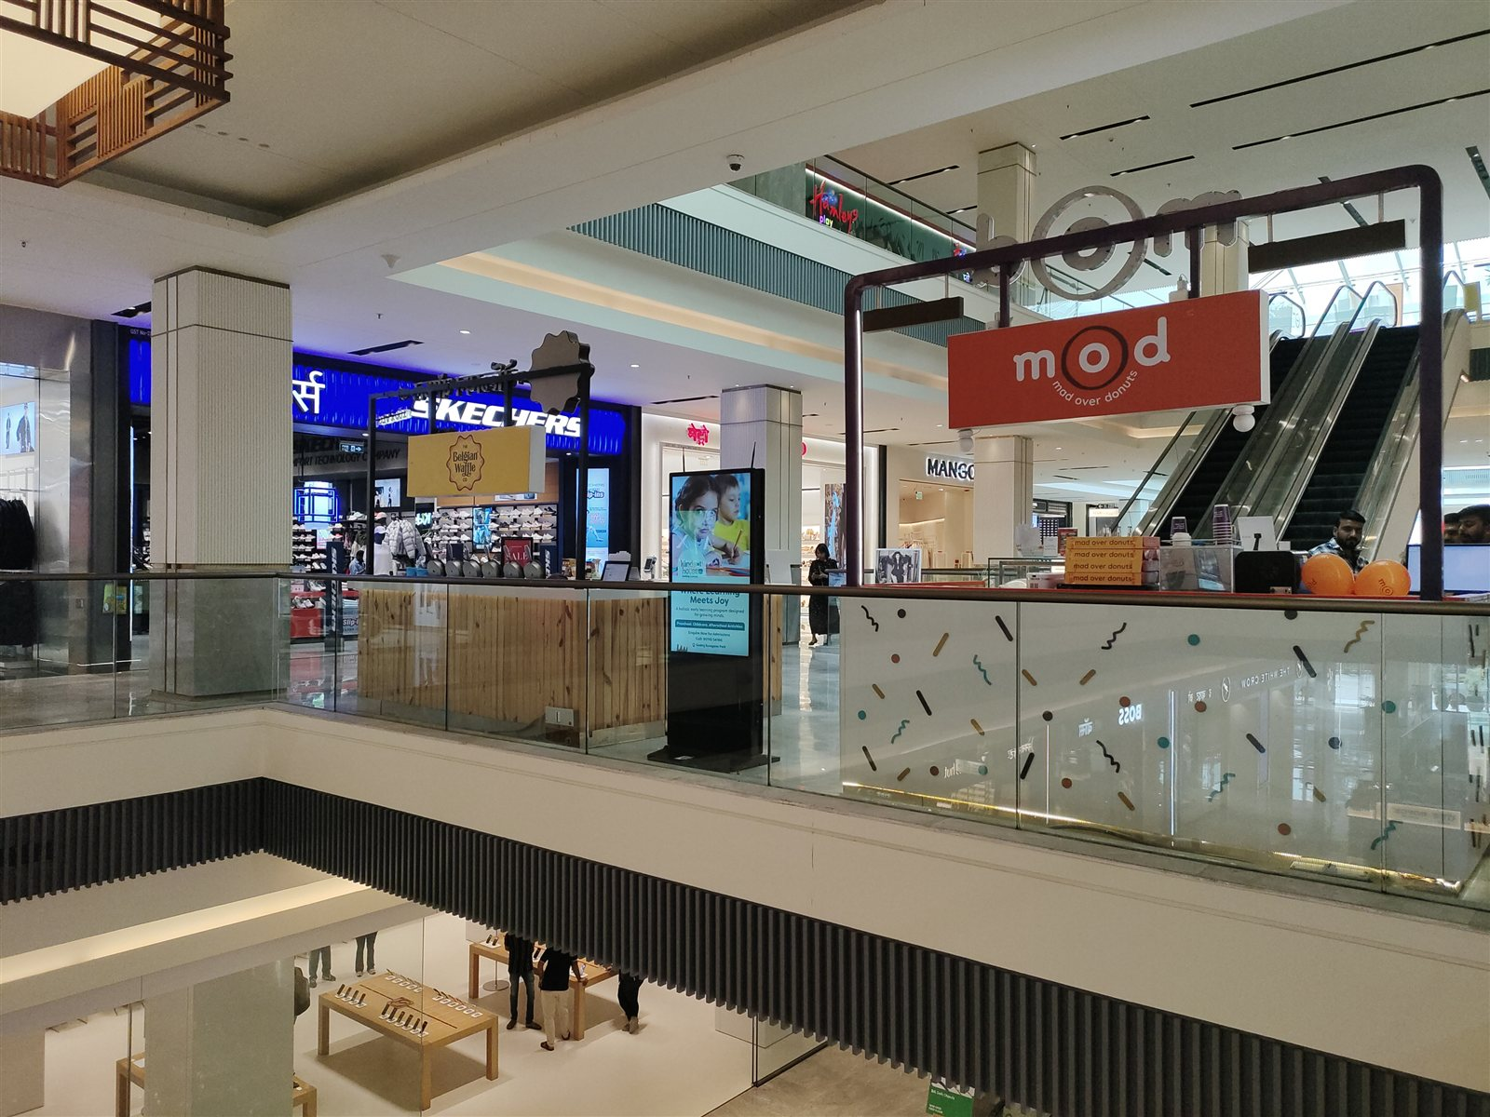
11 / 37
First Floor, Near Skechersâ€“ Double Side Display · Koregaon Park · Pune
SIZE (INCHES)
Digital Pod
55"
RESOLUTION
2160 x 1200

Slide 14
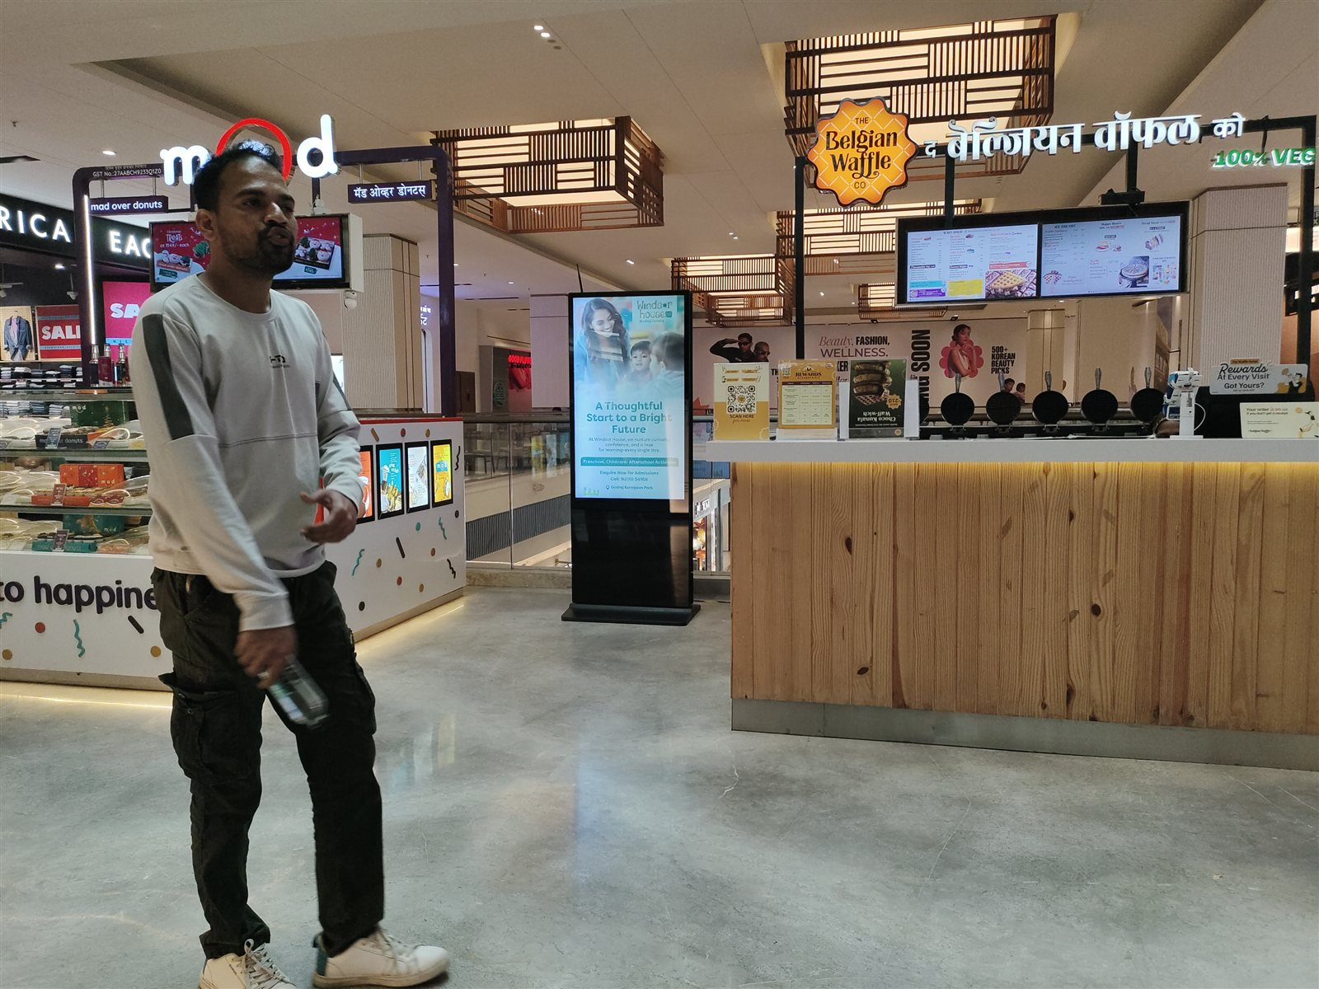
12 / 37
First Floor, Near Skechersâ€“ Double Side Display · Koregaon Park · Pune
SIZE (INCHES)
Digital Pod
55"
RESOLUTION
2160 x 1200

Slide 15
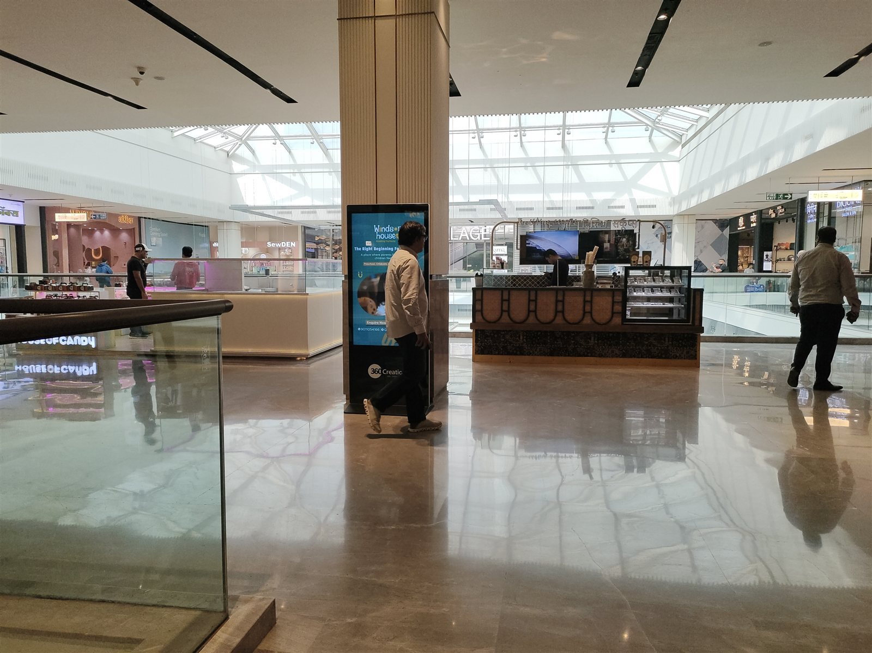
13 / 37
Second Floor, Near Socialâ€“ Single Side Display · Koregaon Park · Pune
SIZE (INCHES)
Digital Pod
55"
RESOLUTION
2160 x 1200

Slide 16
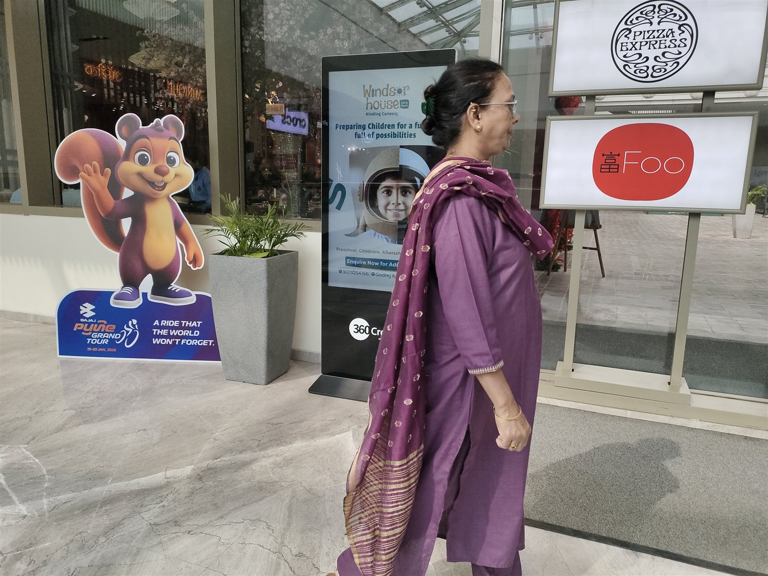
14 / 37
Second Floor, Near The Villageâ€“ Single Side Display · Koregaon Park · Pune
SIZE (INCHES)
Digital Pod
55"
RESOLUTION
2160 x 1200

Slide 17
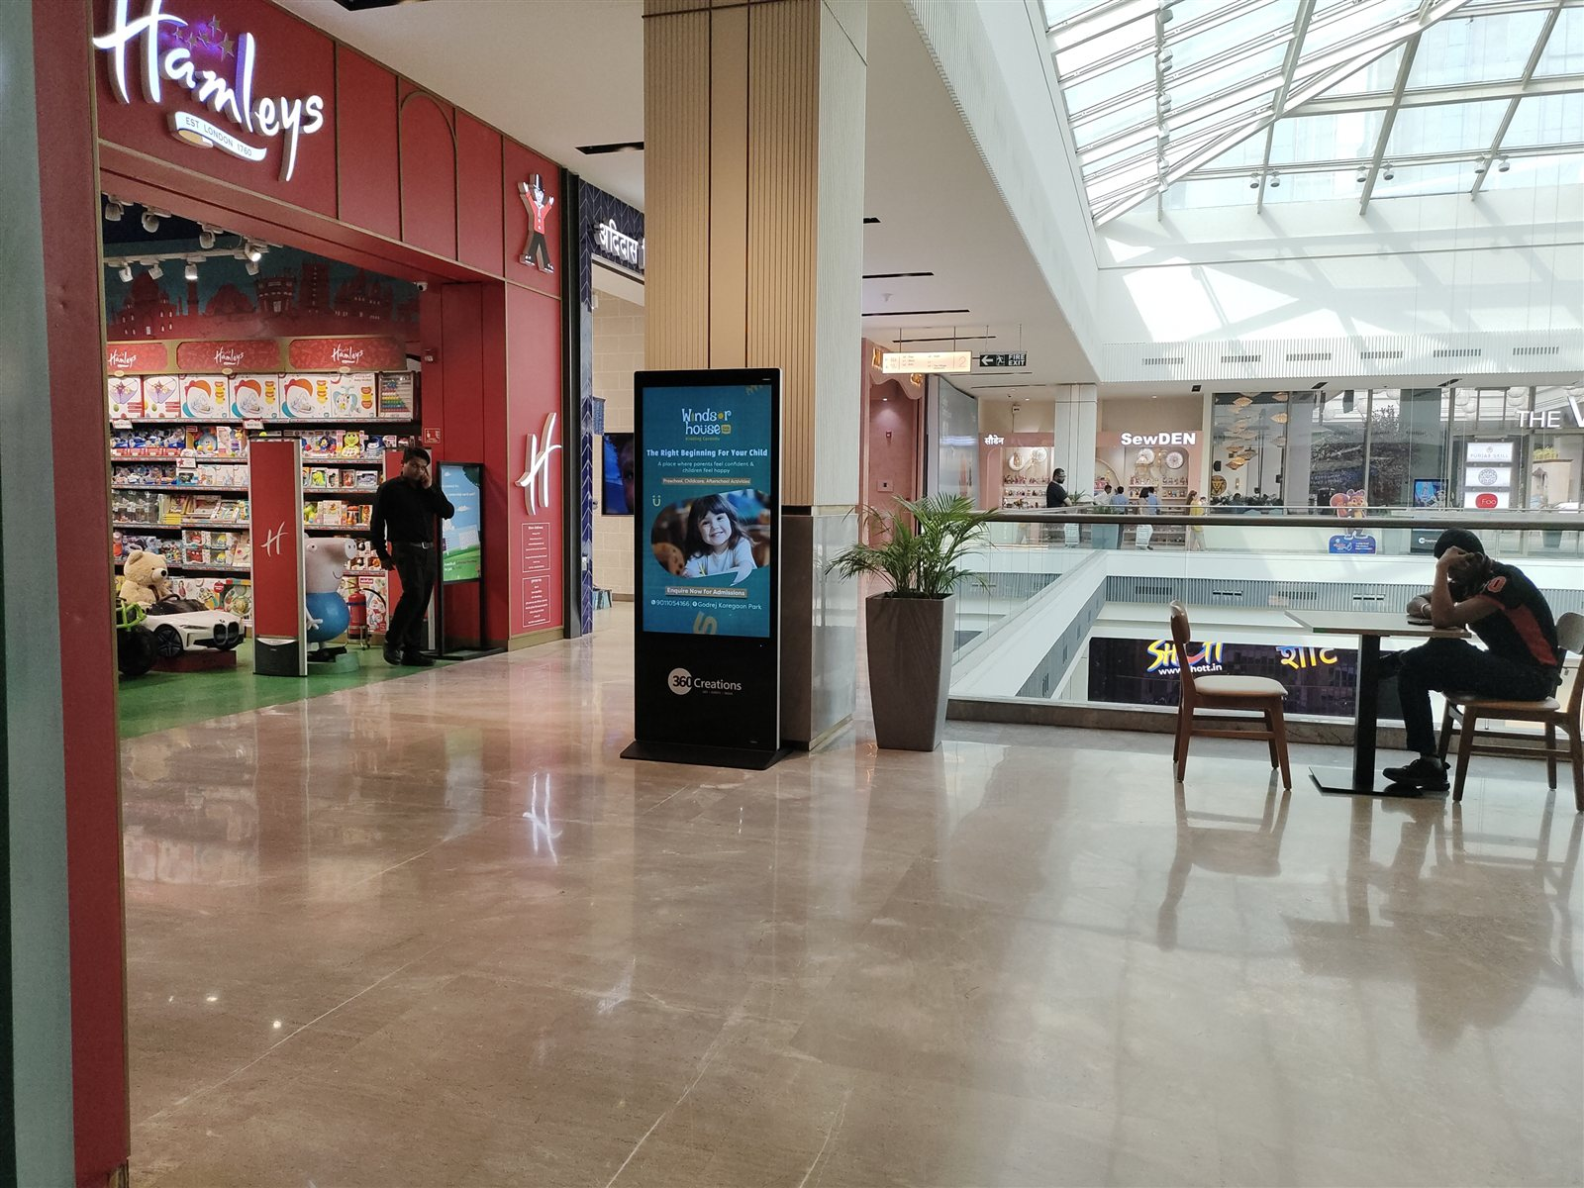
15 / 37
Second Floor, Near Hamleysâ€“ Single Side Display · Koregaon Park · Pune
SIZE (INCHES)
Digital Pod
55"
RESOLUTION
2160 x 1200

Slide 18
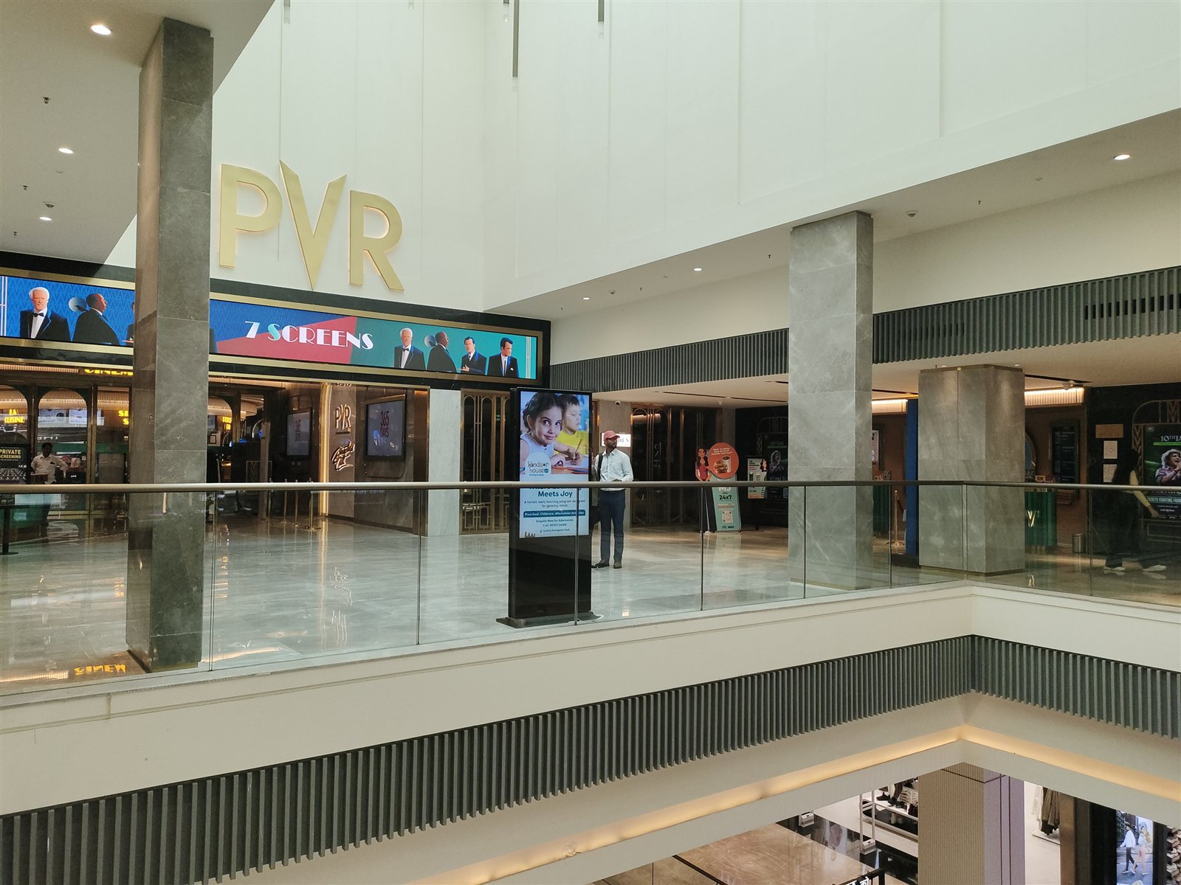
16 / 37
Second Floor, Opp PVRâ€“ Double Side Display · Koregaon Park · Pune
SIZE (INCHES)
Digital Pod
55"
RESOLUTION
2160 x 1200

Slide 19
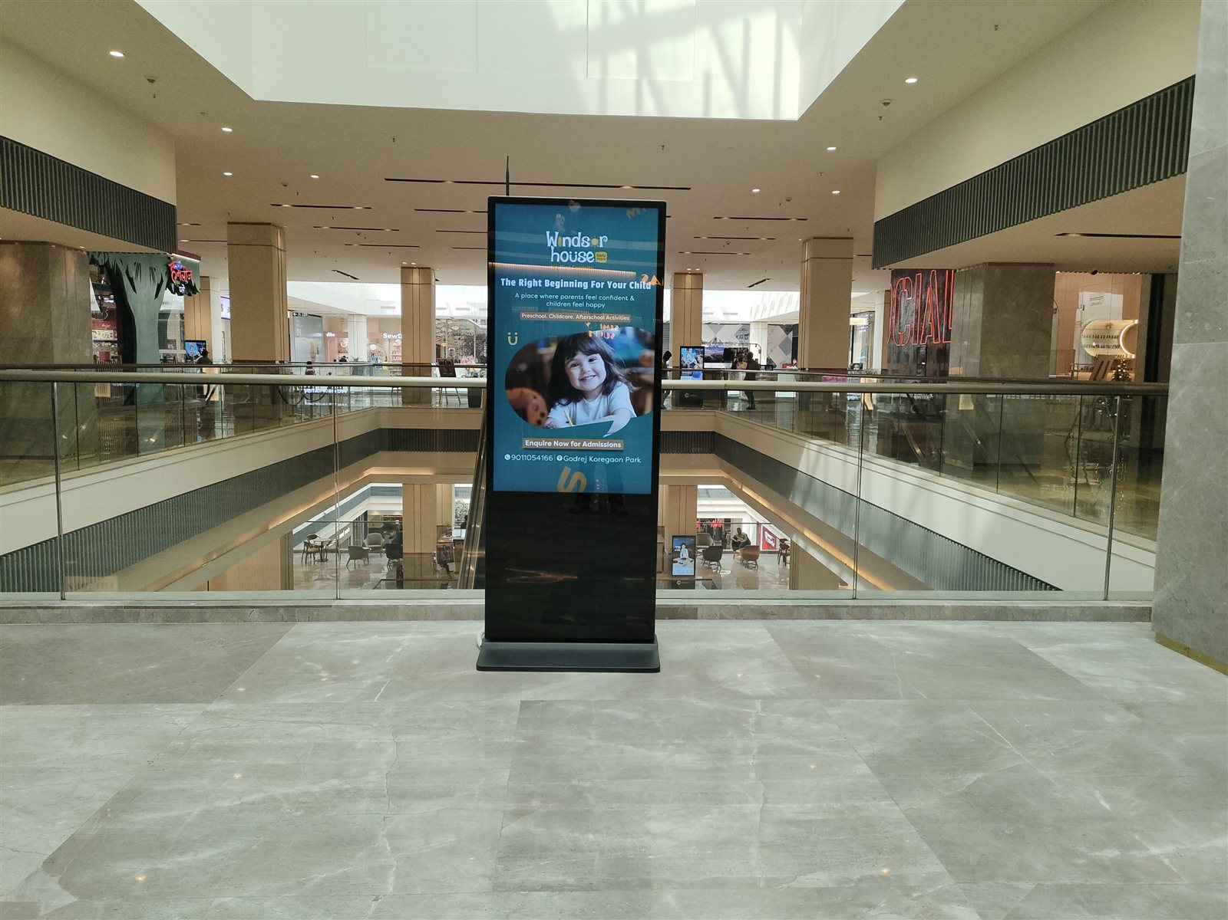
17 / 37
Second Floor, Opp PVRâ€“ Double Side Display · Koregaon Park · Pune
SIZE (INCHES)
Digital Pod
55"
RESOLUTION
2160 x 1200

Slide 20
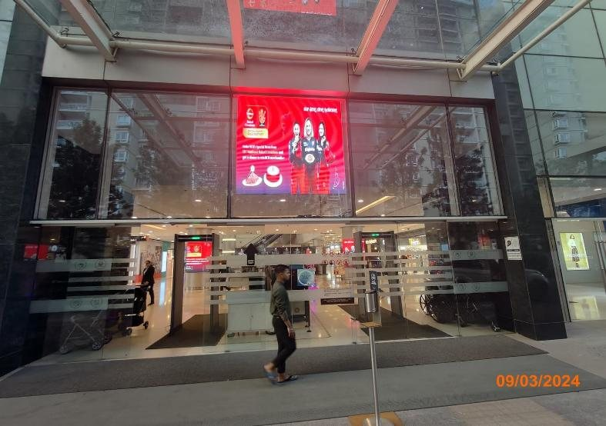
18 / 37
Entry · Yelahanka · Bengaluru
SIZE (FT)
LED Screen
7 (W) x 7 (H)

Slide 21
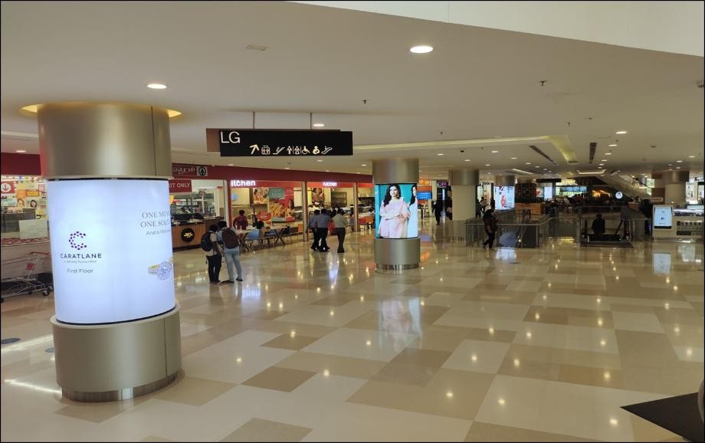
19 / 37
Pillar Wrap Ground Floor · Yelahanka · Bengaluru
SIZE (FT)
LED Screen
12 (W) x 6 (H)

Slide 22
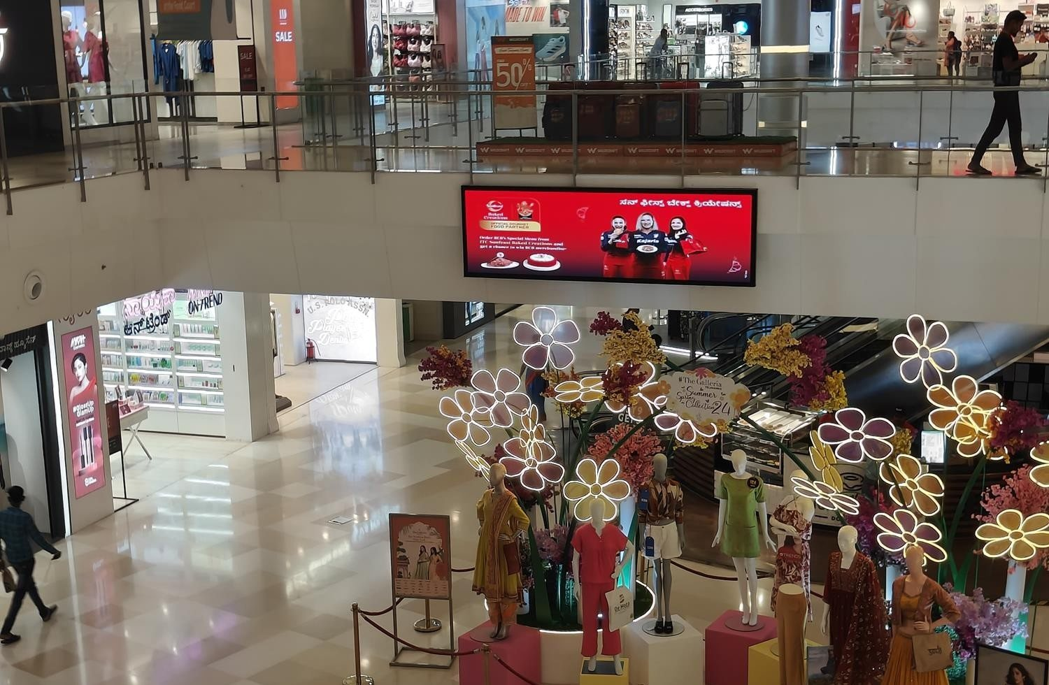
20 / 37
UG Above VH · Yelahanka · Bengaluru
SIZE (FT)
LED Screen
12 (W) x 3 (H)

Slide 23
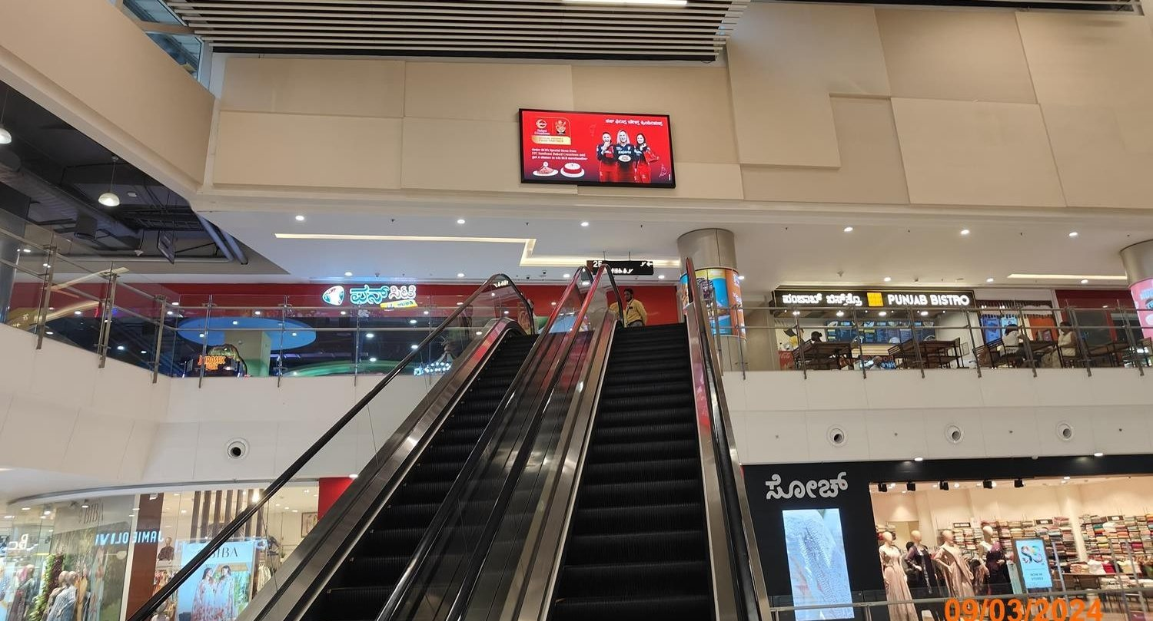
21 / 37
Food Court Wall Above Fun City · Yelahanka · Bengaluru
SIZE (FT)
LED Screen
10 (W) x 5 (H)

Slide 24
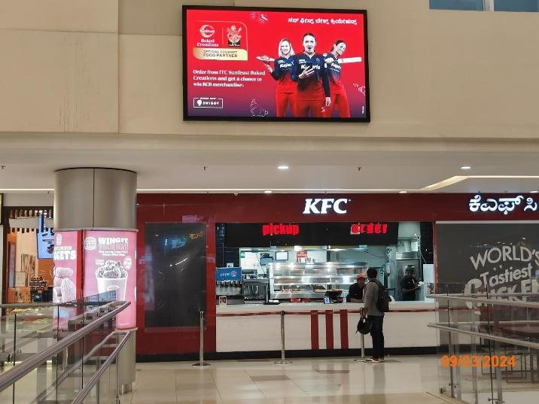
22 / 37
Food Court Wall Above KFC · Yelahanka · Bengaluru
SIZE (FT)
LED Screen
8 (W) x 5 (H)

Slide 25
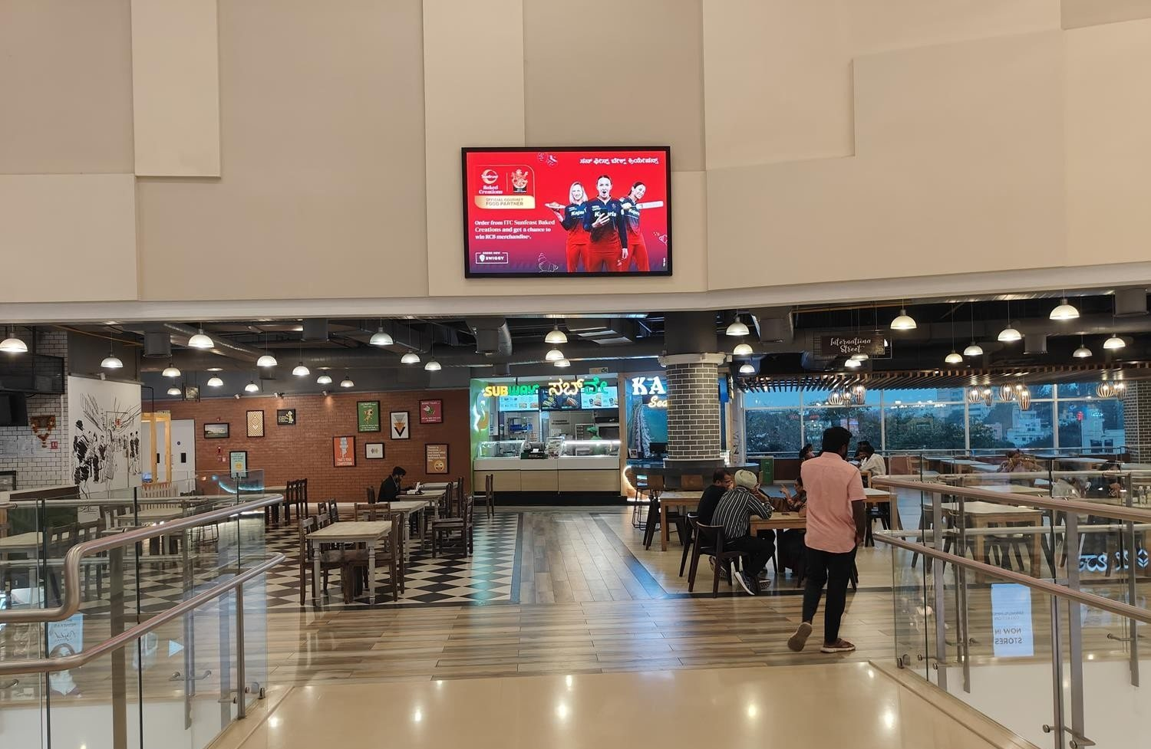
23 / 37
Food Court Wall Above Subway · Yelahanka · Bengaluru
SIZE (FT)
LED Screen
8 (W) x 5 (H)

Slide 26
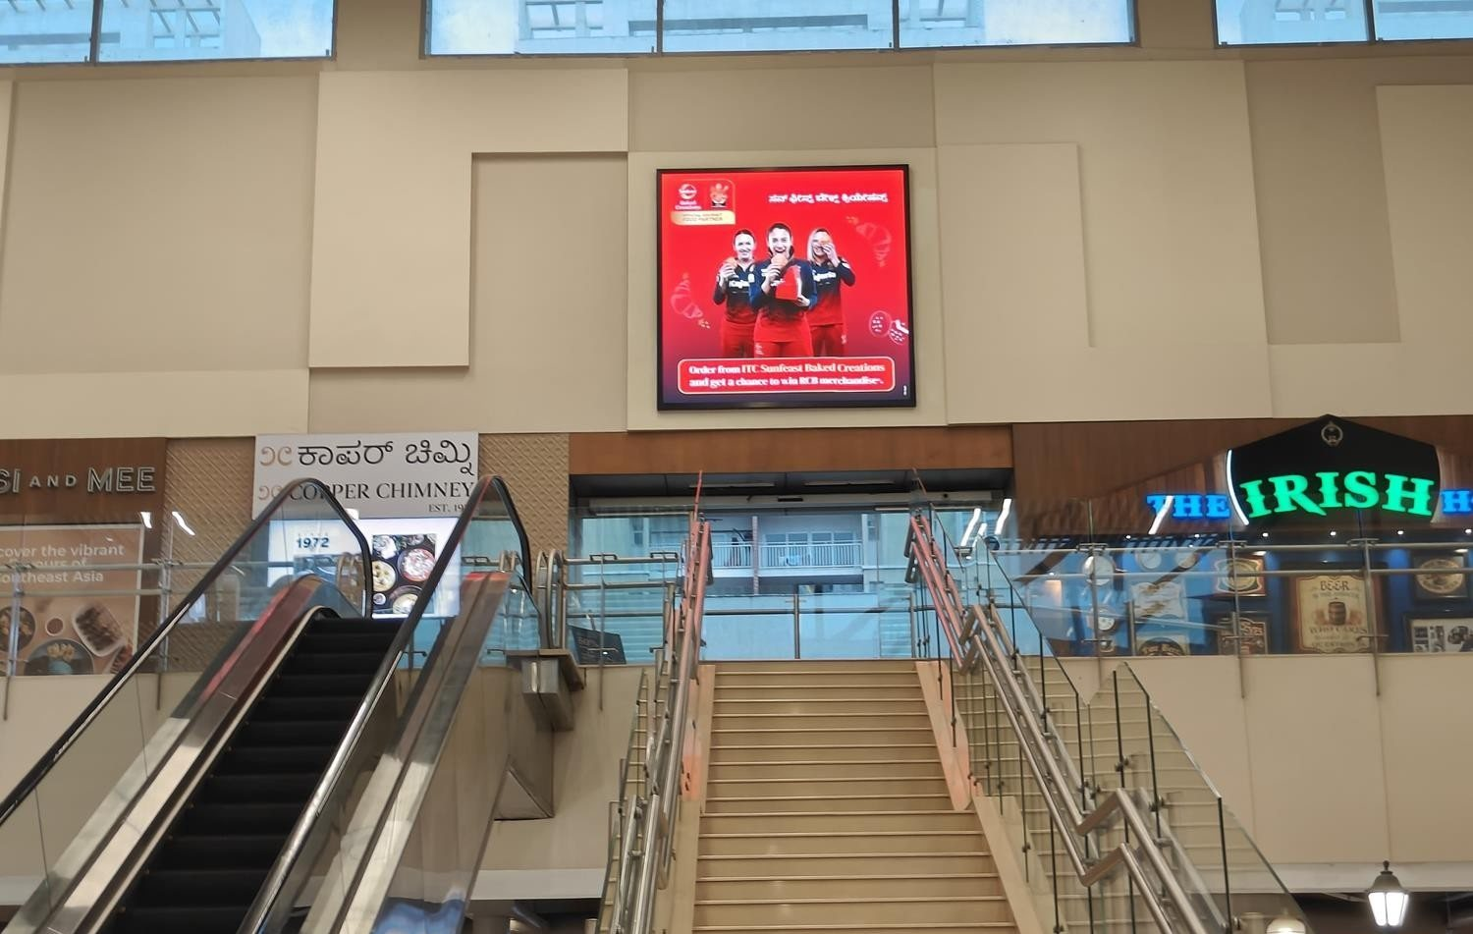
24 / 37
Above Irish House · Yelahanka · Bengaluru
SIZE (FT)
LED Screen
8 (W) x 8 (H)

Slide 27
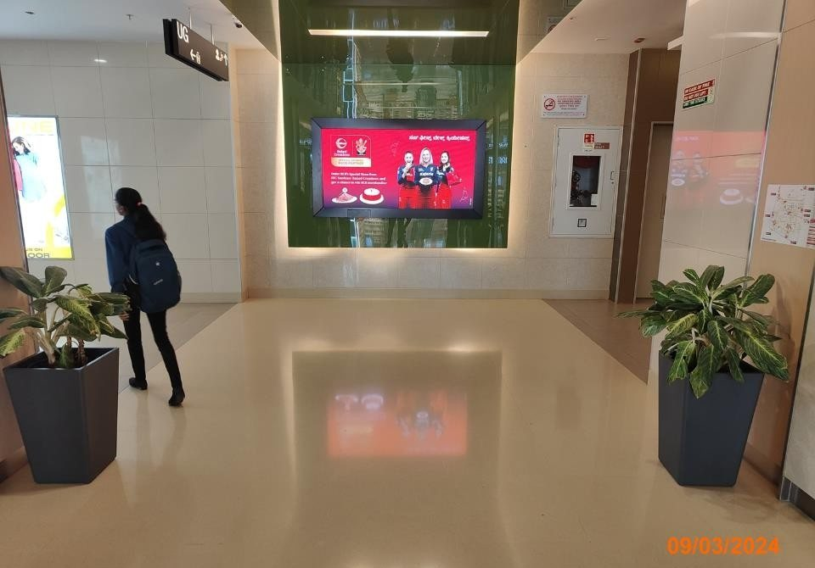
25 / 37
Lift Lobby UG · Yelahanka · Bengaluru
SIZE (FT)
LED Screen
7 (W) x 3 (H)

Slide 28
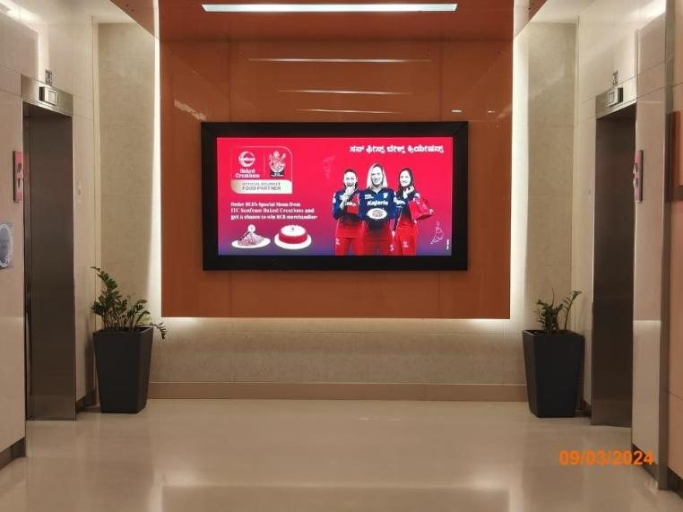
26 / 37
Lift Lobby LG · Yelahanka · Bengaluru
SIZE (FT)
LED Screen
7 (W) x 3 (H)

Slide 29
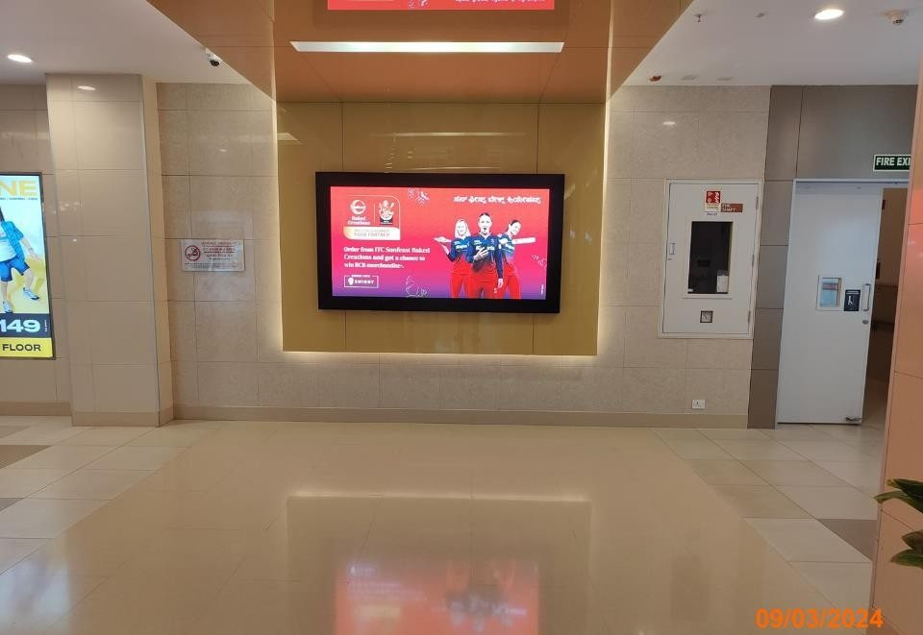
27 / 37
Lift Lobby First Floor · Yelahanka · Bengaluru
SIZE (FT)
LED Screen
7 (W) x 3 (H)

Slide 30
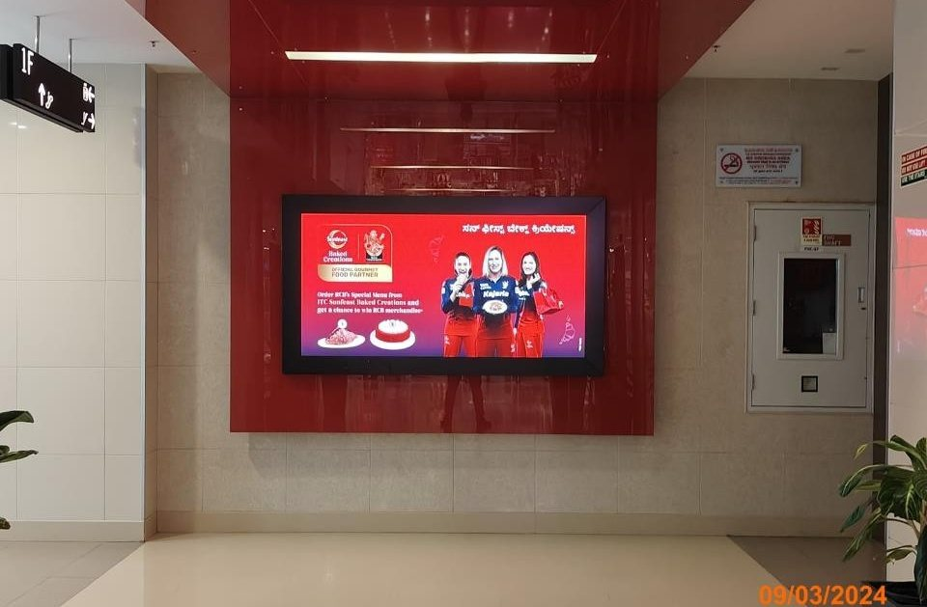
28 / 37
Lift Lobby Second Floor · Yelahanka · Bengaluru
SIZE (FT)
LED Screen
7 (W) x 3 (H)

Slide 31
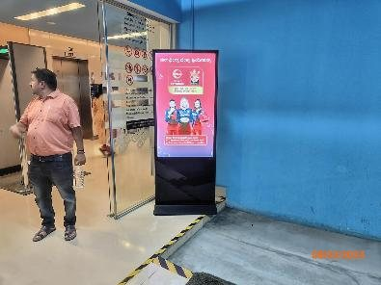
29 / 37
Various Locations · Yelahanka · Bengaluru
SIZE (FT)
LED Screen
2 (W) x 4 (H)

Slide 32
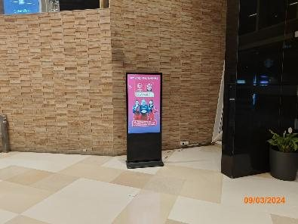
30 / 37
Various Locations · Yelahanka · Bengaluru
SIZE (FT)
LED Screen
2 (W) x 4 (H)

Slide 33
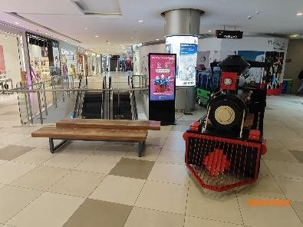
31 / 37
Various Locations · Yelahanka · Bengaluru
SIZE (FT)
LED Screen
2 (W) x 4 (H)

Slide 34
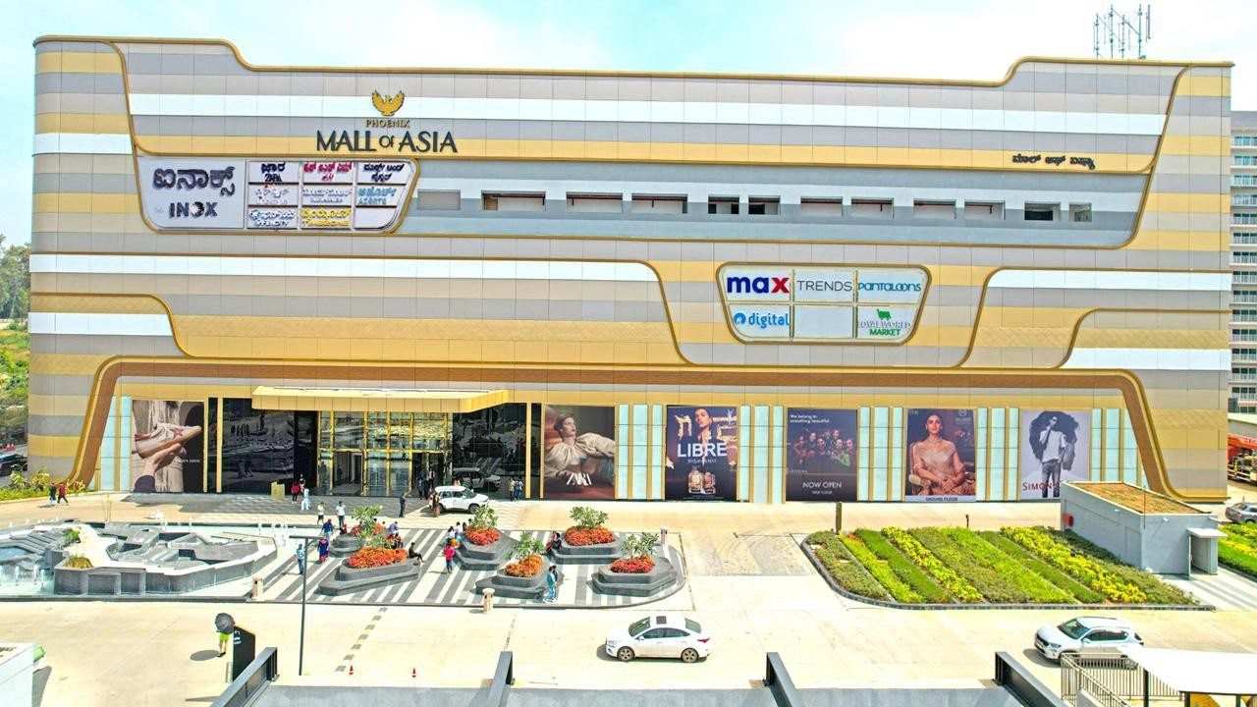
32 / 37
West faÃ§ade · Hebbal · Bengaluru
SIZE (FT)
Facade
17.3 (W) x 21.5 (H)

Slide 35
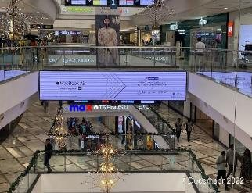
33 / 37
Twrds Basement/mall entry · Velachery · Chennai
SIZE (FT)
LED Screen
22 (W) x 4 (H)

Slide 36
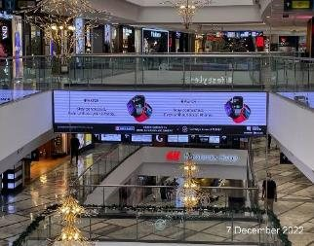
34 / 37
Twrds Basement/mall entry · Velachery · Chennai
SIZE (FT)
LED Screen
22 (W) x 4 (H)

Slide 37
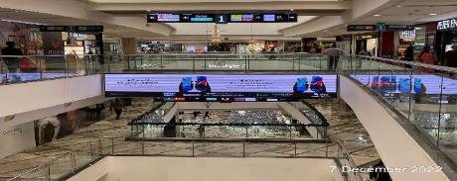
35 / 37
Twrds Basement/mall entry · Velachery · Chennai
SIZE (FT)
LED Screen
22 (W) x 4 (H)

Slide 38
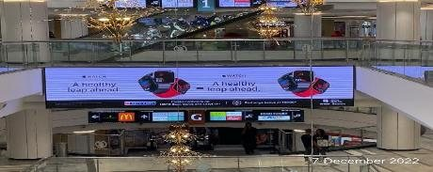
36 / 37
Twrds Basement/mall entry · Velachery · Chennai
SIZE (FT)
LED Screen
22 (W) x 4 (H)

Slide 39
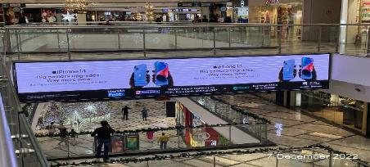
37 / 37
Twrds Basement/mall entry · Velachery · Chennai
SIZE (FT)
LED Screen
22 (W) x 4 (H)

Slide 40
THANK YOU
Northstar Outdoor

